Slide 1

JUET YOUTH CLUB
.

Slide 2
Annual sports Fest
sangharsh 2k17

Slide 3
For sports enthusiasts,Sangharsh is a platform created for extramural participants by JAYPEE UNIVERSITY OF ENGINEERING AND TECHNOLOGY.This intercollegiate will have footfall from across the nation.
This fest guarantees 3 days of cut-throat competition,where the participants get to use and hone their talents.It provides great exposure as they get to be part of such an institute.Sangharsh aims at reaching to an exhilarating and unforgetable experience to all its participants.

Slide 4
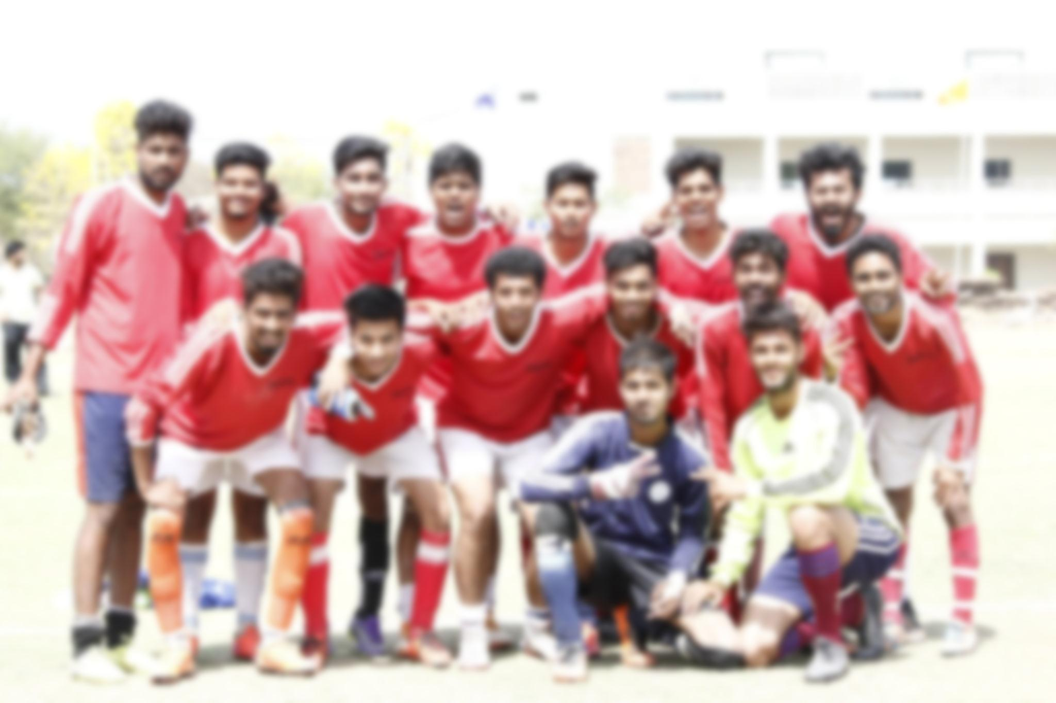
football

Slide 5
Football is football and talent is talent. But the mindset of your team makes all the difference.

Slide 6
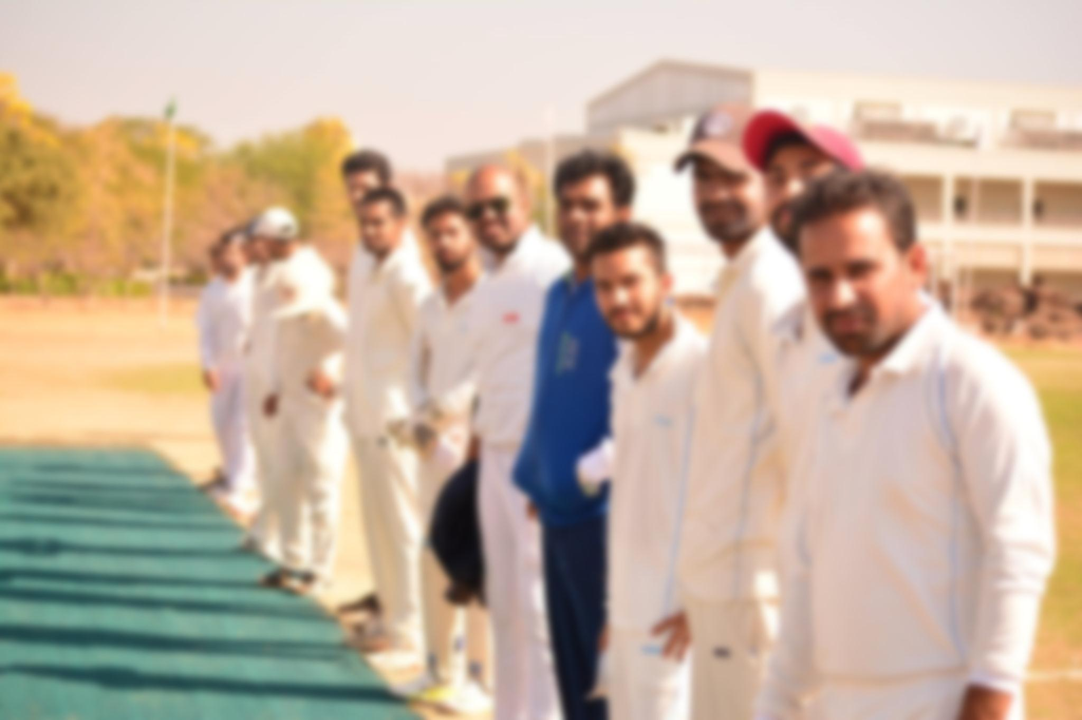
cricket

Slide 7
If what you did yesterday still looks big to you then you have not done much today.

Slide 8

basketball

Slide 9
Set your goals high and don’t stop till you get there.

Slide 10
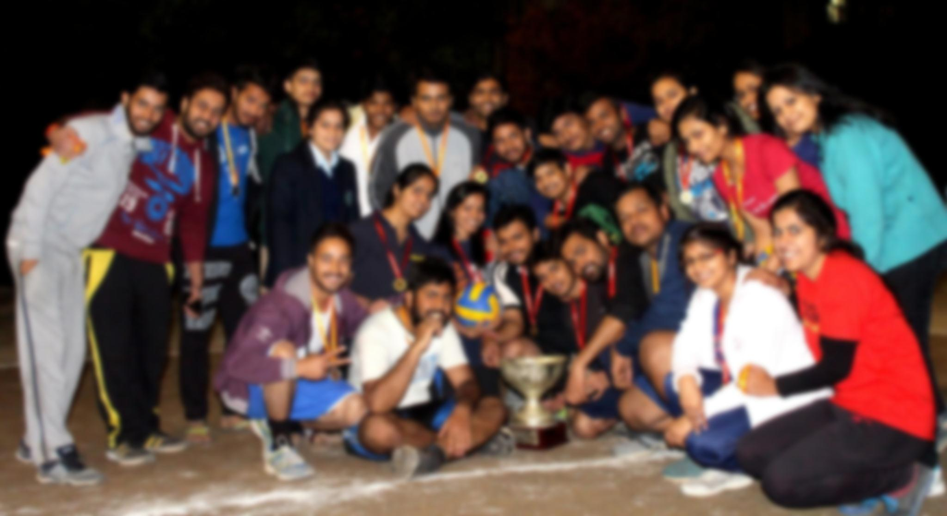
volleyball

Slide 11
Its not the will not win that matters –everyone has that its the will to prepare to win that matters.

Slide 12
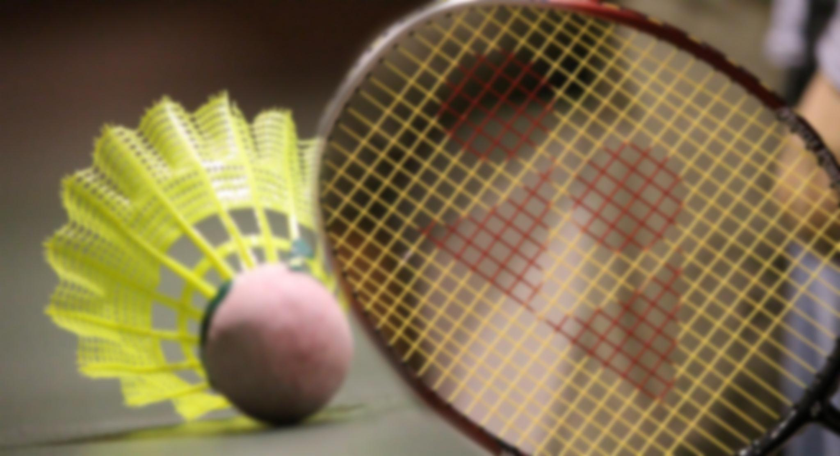
badminton

Slide 13
When you have got something to prove then there is nothing greater than a challenge.

Slide 14
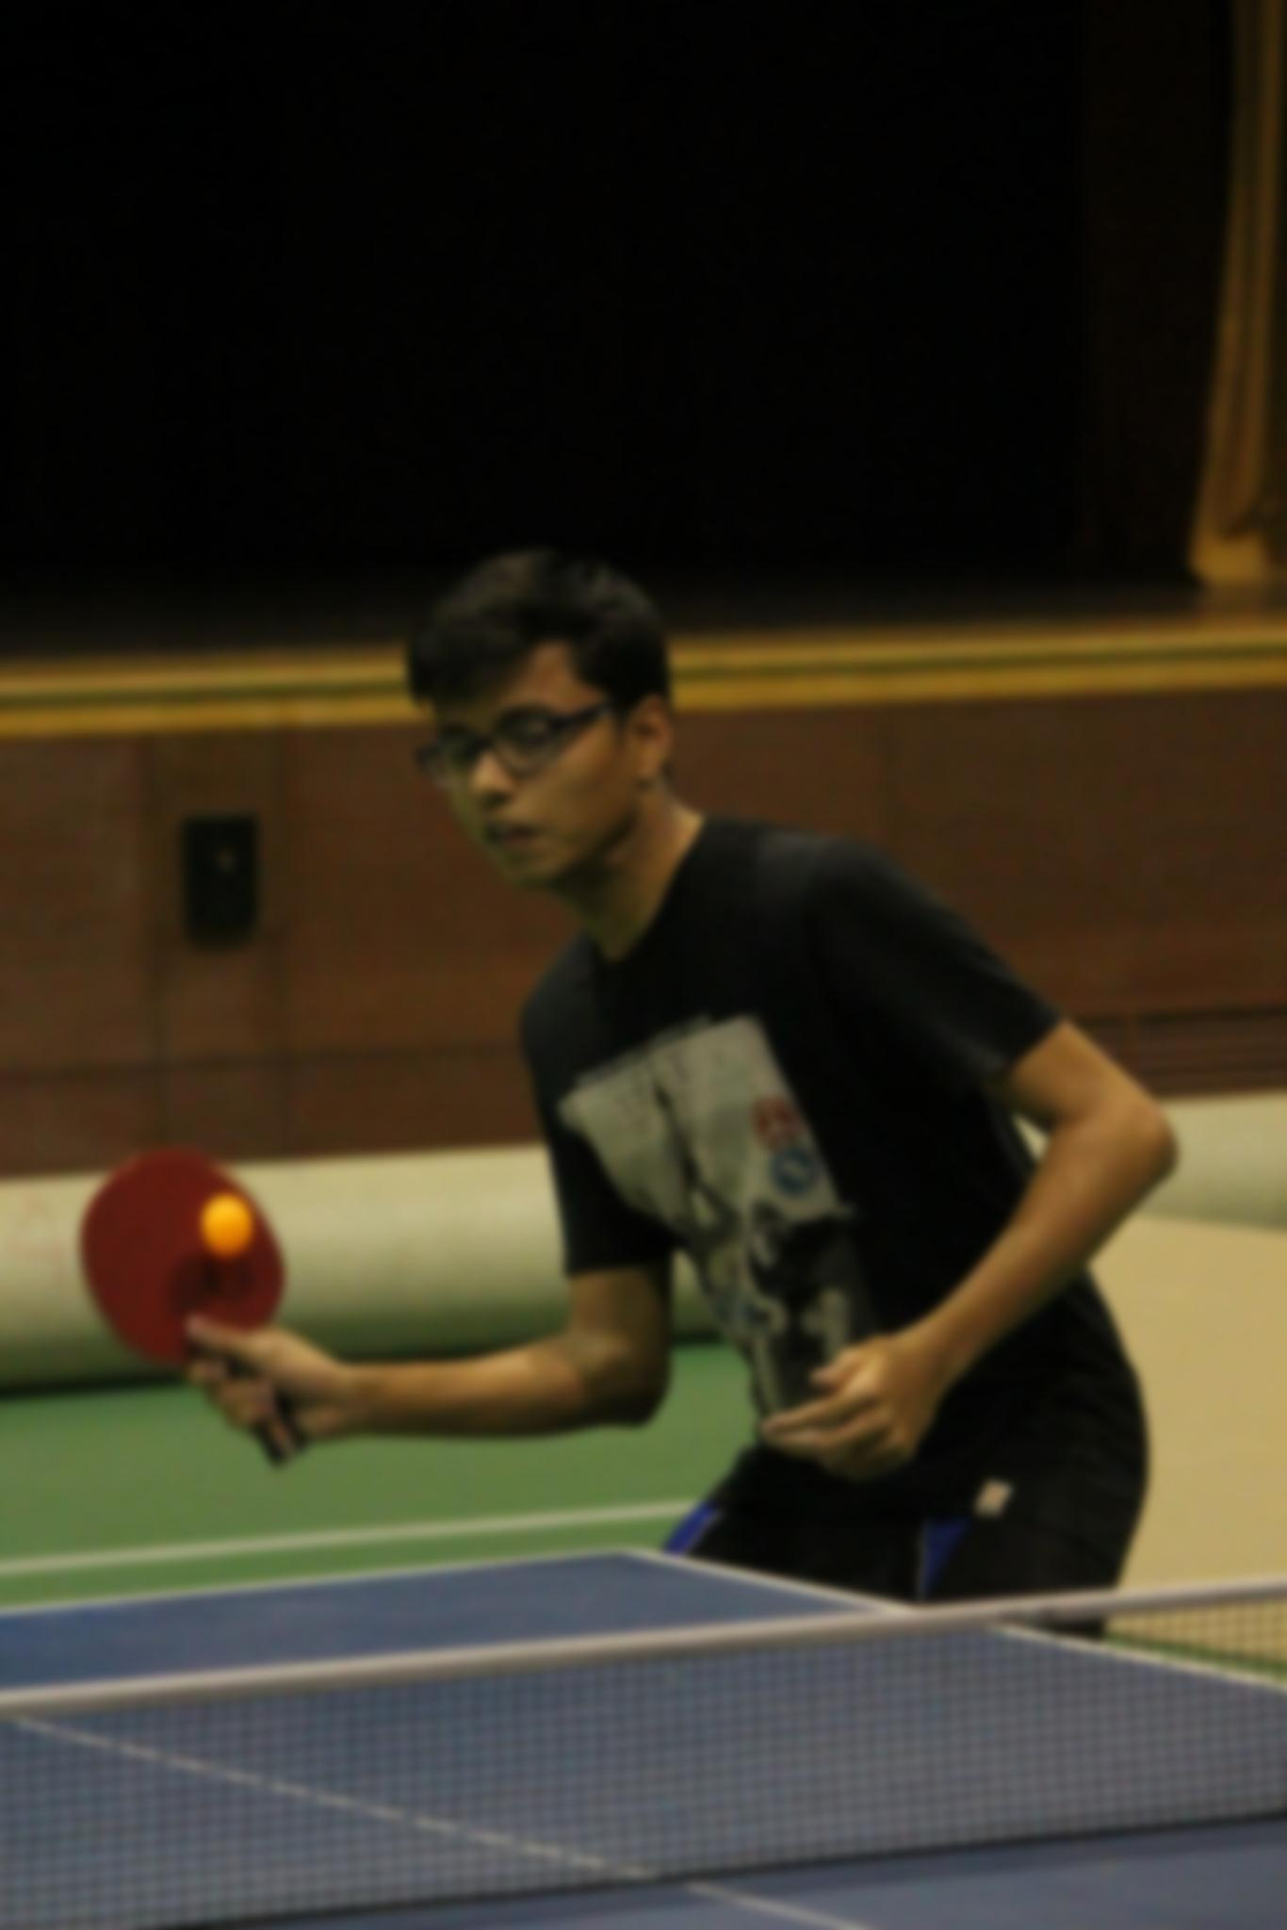
Table tennis

Slide 15
You don’t always get what you wish for,you always get what you work for.

Slide 16
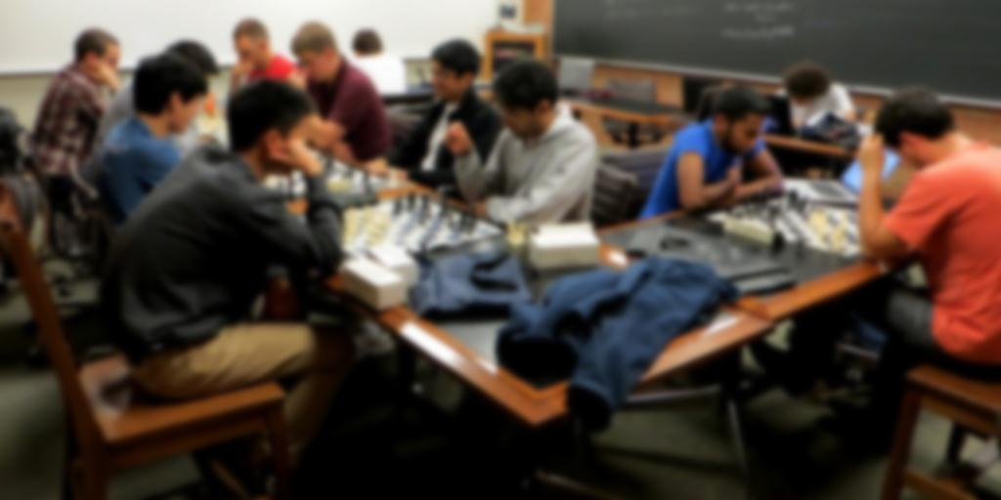
chess

Slide 17
If you are not big enough to loose,you are not big enough to win.

Slide 18
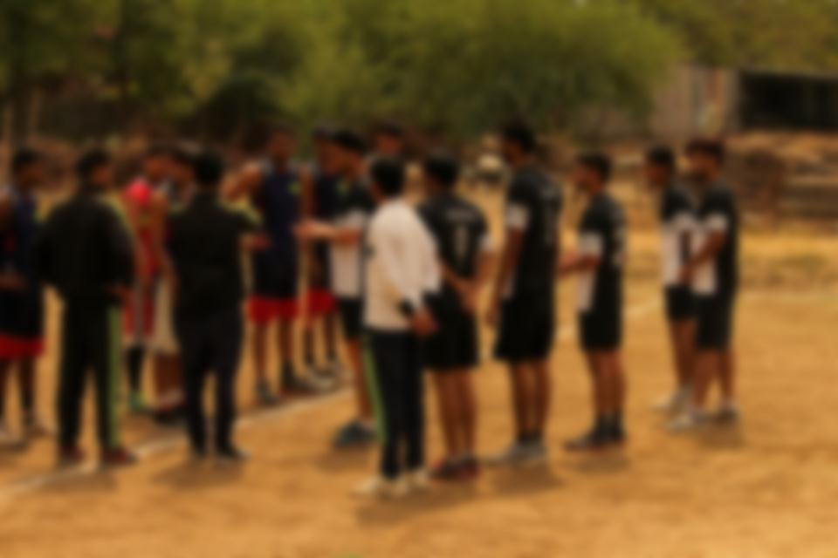
handball

Slide 19
It never gets easier,you just get better.

Slide 20
Budget for Sangharsh 2K17
Allocated budget:1 LAKH
Eventwise allocation of Budget
SNO. | EVENT | AMOUNT | DETAILS
1. | Cash prizes | 37000 | As per annexure 1
2. | Medals | 4100 | As per annexure 2
3. | Trophies | 2200 | As per annexure 2

Slide 21
SNO. | EVENT | AMOUNT | DETAILS
4. | Jury(referees) | 25000 | -
5. | Accomodation | 15500 | As per annexure1
6. | Miscellaneous | 10000 | -
TOTAL | 93800

Slide 22
Annexure 1
SNO. | EVENT | AMOUNT
1. | Cricket | 6000
2. | Basketball(boys) | 4000
3. | Basketball(girls) | 2000
4. | Volleyball(boys) | 4000
5. | Volleyball(girls) | 2000

Slide 23
SNO. | EVENT | AMOUNT
6. | Badminton(boys) | 3000
7. | Badminton(girls) | 2000
8. | TableTennis(b) | 3000
9. | TableTennis(g) | 2000
 | TOTAL | 37000

Slide 24
SNO. | EVENT | AMOUNT
1. | Cricket | 6000
2. | Basketball(boys) | 4000
3. | Basketball(girls) | 2000
4. | Volleyball(boys) | 4000
5. | Volleyball(girls) | 2000
6. | Badminton(boys) | 3000

Slide 25
Annexure 2 Medals and Trophies
SNO | ITEM | QUANTITY | PRICE/UNIT | AMOUNT
1. | Gold Medal | 106 | 20 | 2120
2. | Silver Medal | 106 | 18 | 1908
3. | Trophies | 11 | 200 | 2200
TOTAL | 6228

Slide 26
Annexure 3 Accomodation
SNo. | Items | No.of days | Quantity | Price/unit | Amount
1. | Bedsheet | 3 | 250 | 10 | 7500
2. | Tent,Stall and chairs | 3 | - | - | 8000
TOTAL | 15500

Slide 27
Annual Cultural Fest
D’EQUINOX 2k18

Slide 28
3 Day cultural fest open for participation from sister universities as well as other esteemed educational institutes across the nation.
Major attractions:
Reputed Band
Famous Bollywood Playback Singer
Various day events along with theme nights.
Instrumental VJ Night

Slide 29
MOTIVES OF OPEN CULTURAL FEST
Enhanced participation of students, both from outside and inside the campus.
Better tie-ups with our sister universities in regards to Cultural events as well as transcending beyond that.
Student registrations from outside would result in revenue generation which will be beneficial in taking our event’s standard to the next level.
It will benefit the University by candidly publicizing its cultural, infrastructural and educational facilities.

Slide 30

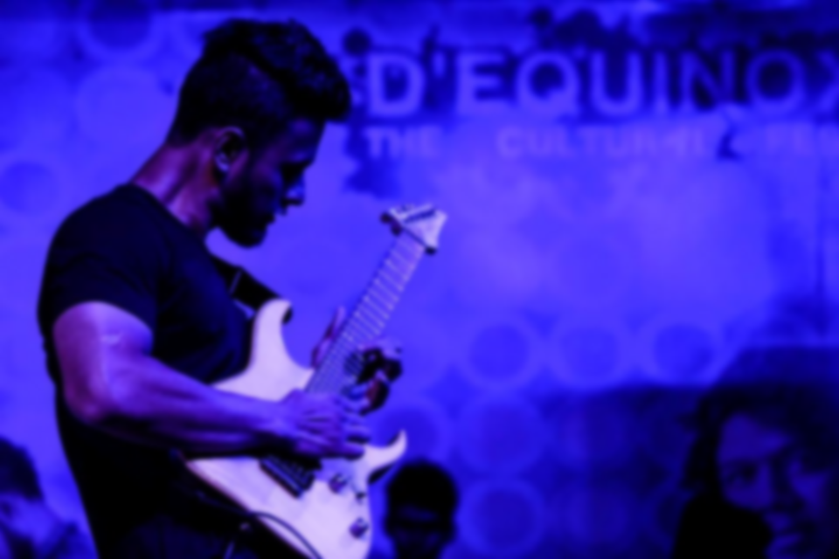
5
RAGA : WAR OF BANDS
RAGA : WAR OF BANDS

Slide 31
Where words fail , music speaks . Captivating vocals , mellifluous keyboard , breath-taking guitars , and spell-binding drums all put together to a gob smacked evening.
Cash prize worth INR 20,000/-
Tentative Budget INR 50,000/-

Slide 32
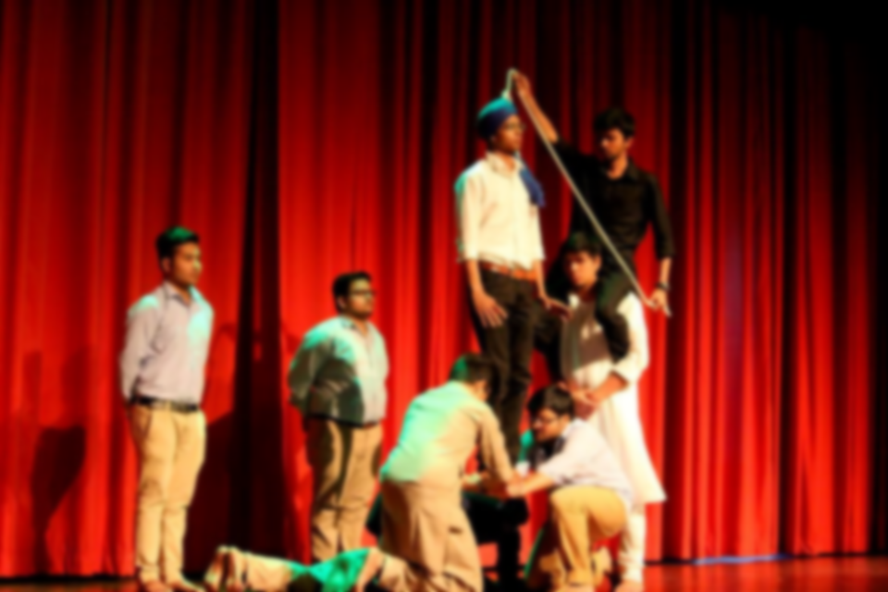
6
STAGECRAFT
6
STAGECRAFT

Slide 33
Life is like a drama . It's an amazing thing to be able to perform and get a reaction from people that don't know you. They don't automatically think you are wonderful because they love you, they love you because of the story you are telling on stage.
Cash prize worth INR 10,000/-

Slide 34
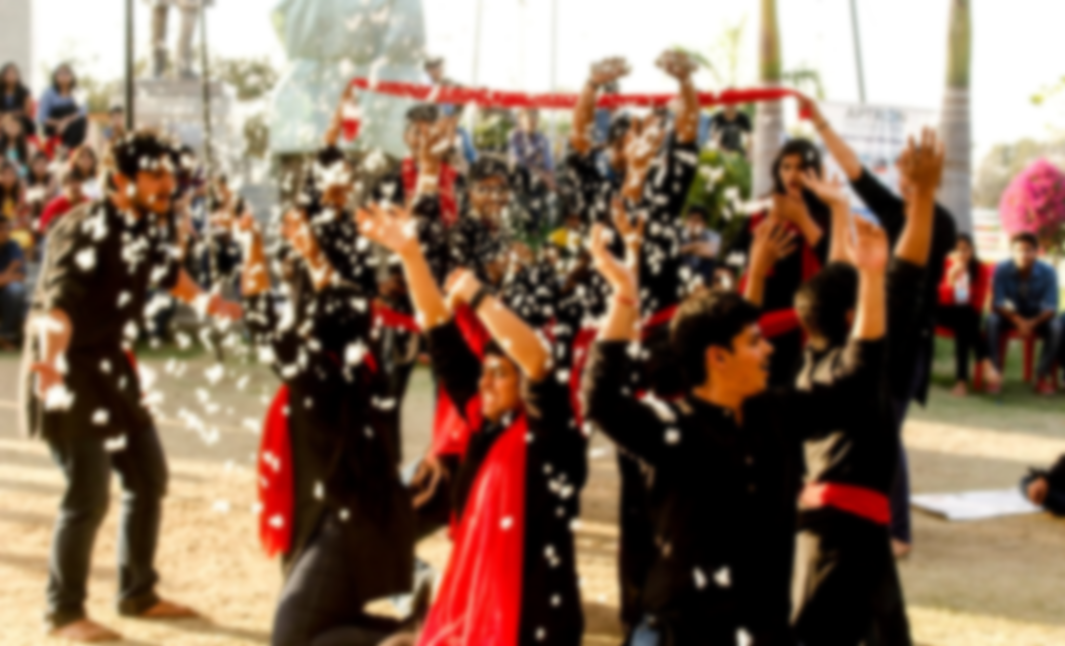
7
NUKKAD NATAK
7
NUKKAD NATAK

Slide 35
From Demonetisation of currency to Global warming bring thunder and lightning in performances that concern you, reality. Voice your thoughts in the most impassioned way through a Nukkad Natak that moves people to action.
Cash prize worth INR 10,000/-

Slide 36
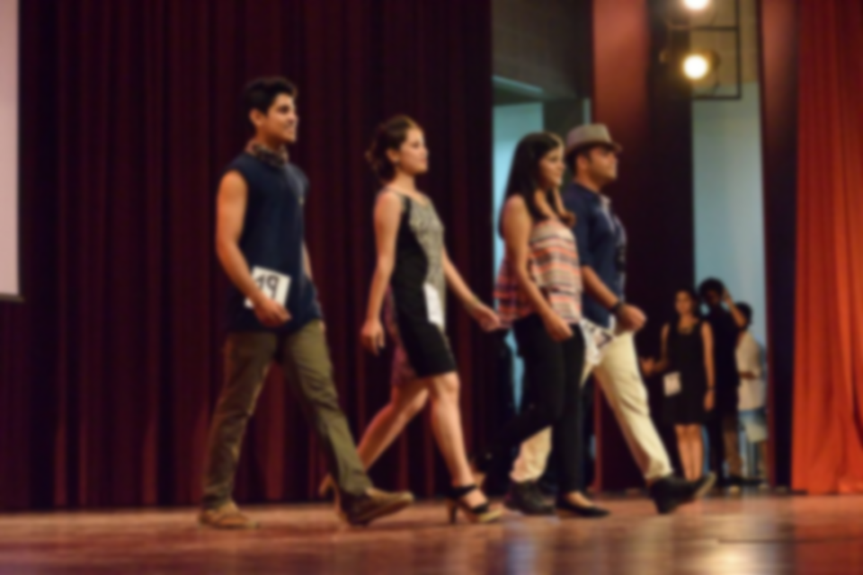
8
VERVE
8
VERVE

Slide 37
Fashion is an individual statement of expression for each of us and VERVE is the avenue to express yourself. It is the chance to set yourself apart in front of an enthusiastic audience.
Cash prize worth INR 15,000/-
Tentative budget INR 2000/-

Slide 38

9
DROPPING NOTES
9
DROPPING NOTES

Slide 39
A platform for the euphonic voices, comprising Solo Singing and Duet Singing.
Cash prize worth INR 10,000/-

Slide 40
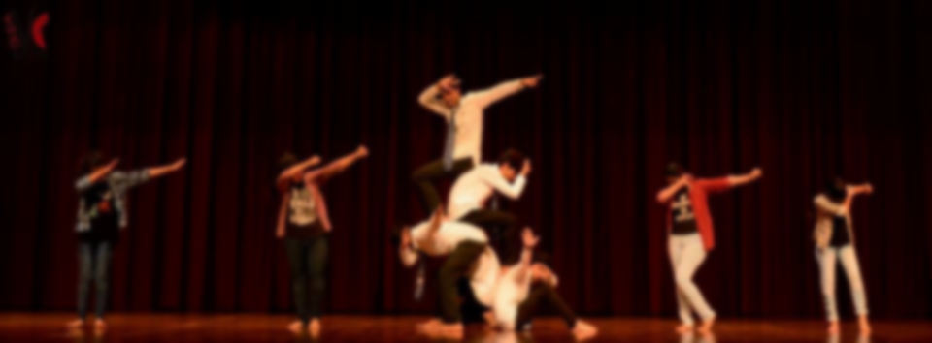
10
SYNC | DOUBLE TROUBLE | walk the moon
10
SYNC | DOUBLE TROUBLE | walk the moon

Slide 41
Sync : It is a group dance competition which brings best dancers under one roof. The group with the most excellent mix of intensity, synchronization, talent and energy will take the trophy.
Double Trouble : Manifest the best of Choreography and chemistry to triumph this Duet Dance bout. Whether you like to shake, wiggle, twirl, or bust a move, make sure you have chemistry with your partner.
Walk The moon : Moves that dazzle you , beats that moves you and elegance that enchants you. If this is what that describes your dance, this is the right place.
Cash prize worth INR 25,000/-

Slide 42
MEDIA WING FEST EVENTS
D’EQUINOX 2k18

Slide 43
Media Wing is the college recognition and fundraising club for students interested in media at the college. We are responsible preserving memories and moments for life long. The club is in a ready-for-change stage where it is time to sponsor more activities and gain more recognition on campus. The purpose of the MEDIA WING is to give students the opportunity to be creative using their talents through digital media. Using digital media, students will collaborate together while getting hands-on experience.

Slide 44
Major Events Conducted by Media Wing:
1.Themography
2. Get Weird 3. Photo-Hunt 4. Tic-Tac-Toe

Slide 45
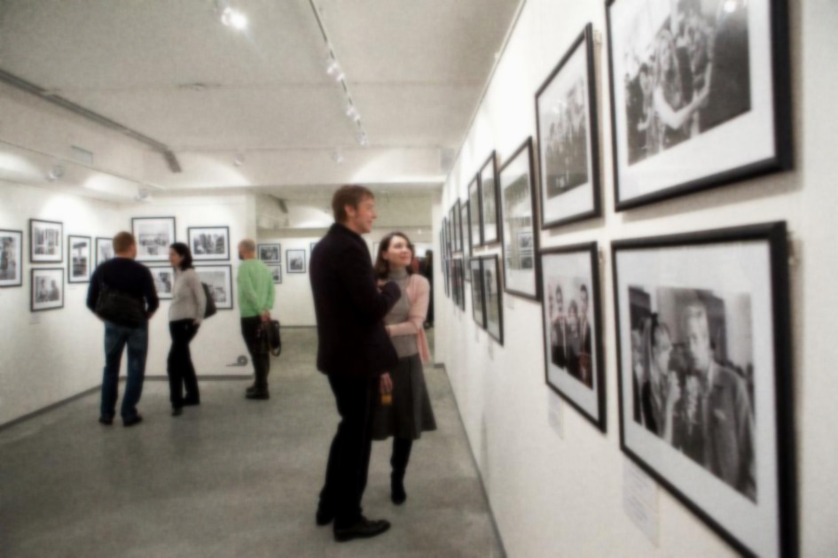
1
Themography

Slide 46
Themography, as the name suggests, is a theme based photography contest. The participants will be given a theme on which they will have to submit a photograph, which will then be put up for voting.
Cash prize worth INR Rs. 5,000/-

Slide 47
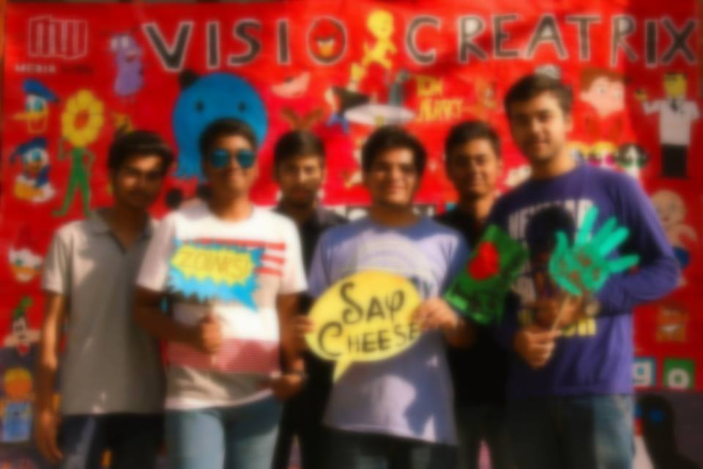
2
Get Weird

Slide 48
The event is basically getting mad with the props and presenting yourself
with the hops, and this moment of yours is going to be captured by the wing
members. The more freaky and funky you get clicked, more are your chances of winning exciting prizes. So just pull up your socks for this fun unleashed
event this D’Equinox. Any member can participate single or in a group.
Cash prize worth INR Rs. 3,000/-

Slide 49

3
Photo-Hunt

Slide 50
Photo hunt is where you can prove yourself , an opportunity to test your skills at deciphering clues in Photographs and deducing connections to reach the final destination to win your way.
Cash prize worth INR Rs. 3,000/-

Slide 51
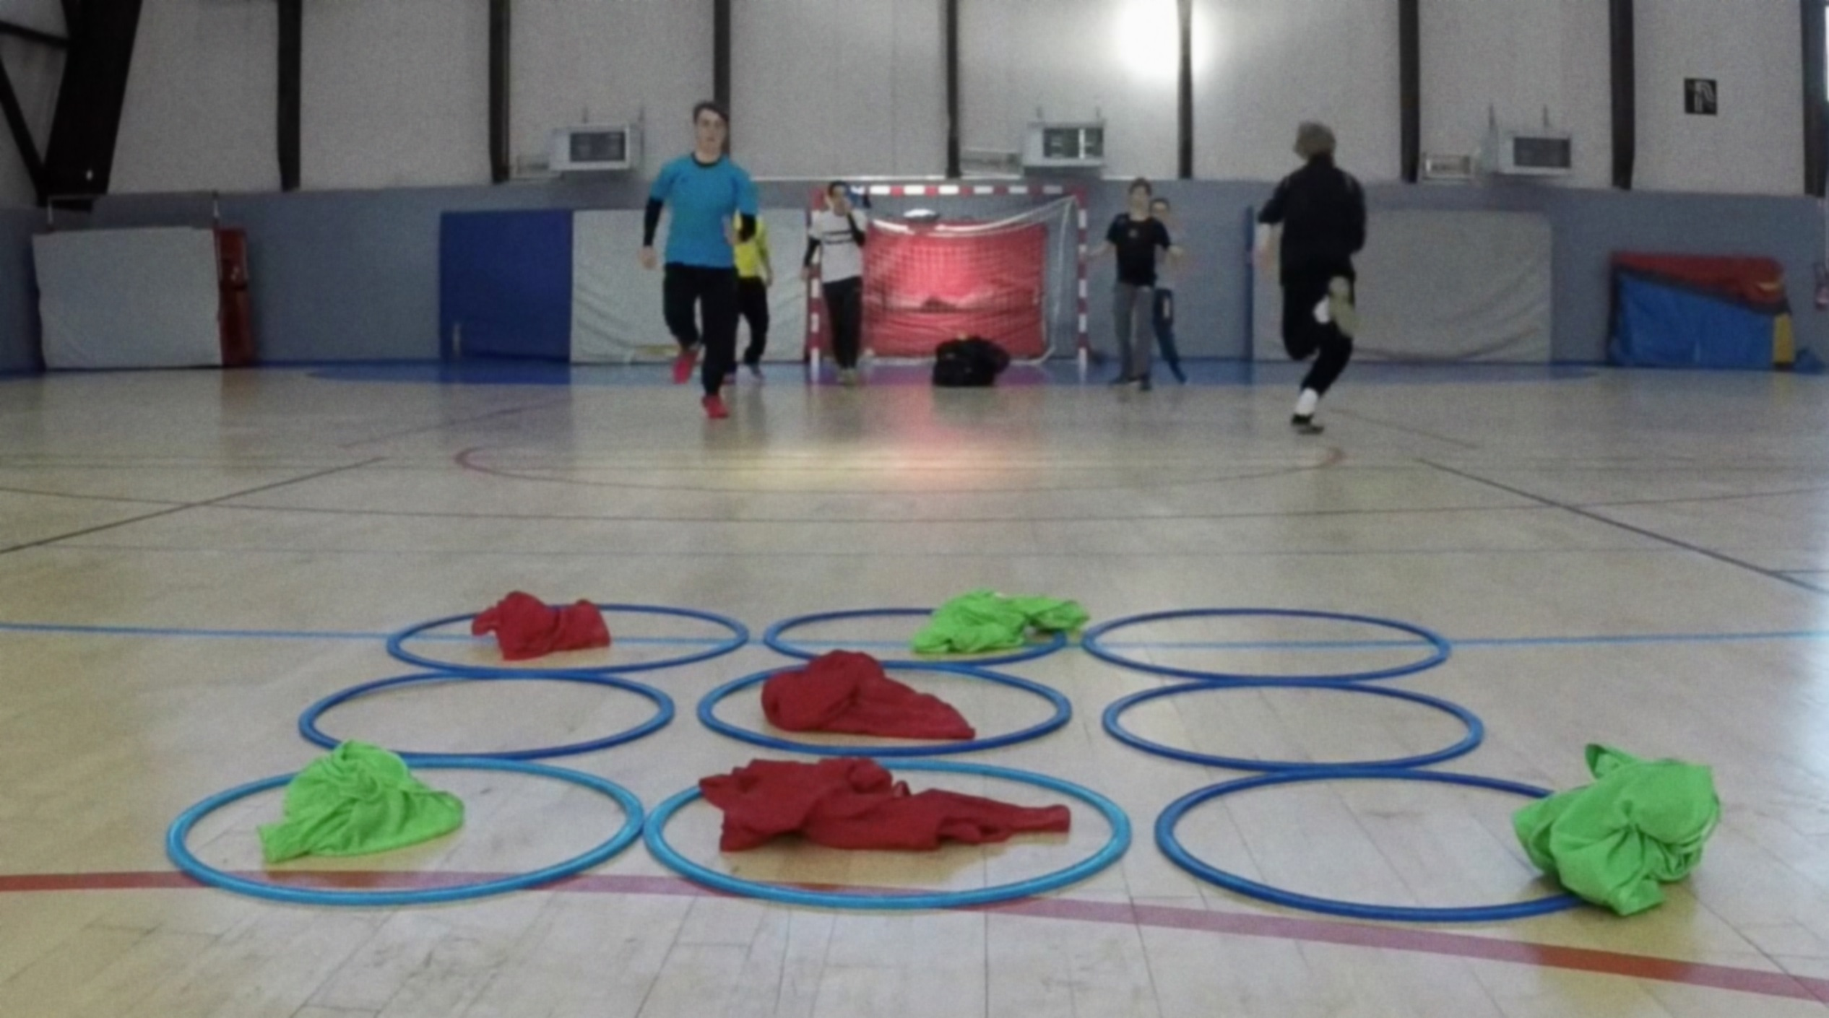
4
Tic-tac-toe

Slide 52
Tic-tac-toe is a paper-and-pencil game but
this time Media Wing presents you this with a twist. In human tic-tac-toe event, students are separated into two teams, X's and O's. There will be a tic tac-toe board on the floor. Each team will receives some piece of cloth.
On spot registrations!
Cash prize worth INR Rs. 3,000/-

Slide 53
Enhancement of skills

Slide 54
Eposure of talent

Slide 55
More opportunities as we cannot learn everything from daily events

Slide 56
We are recognized by the artists we cover. People from other colleges approach us to cover their fests as well

Slide 57
The more stars are involved, the more our college fest is promoted

Slide 58
Our seniors from media wing are currently working at BBC (British Broadcasting Corporation)

Slide 59
Our promotion of artists are seen by many colleges as well, leaving a good impression of JUET behind.

